Slide 1
Evaluating ROVIO and OKVIS – Two Visual-Inertial Odometry Implementations
Julian Surber
Semester Thesis
Supervised by Margarita Chli & Lucas Pinto Teixeira

Slide 2
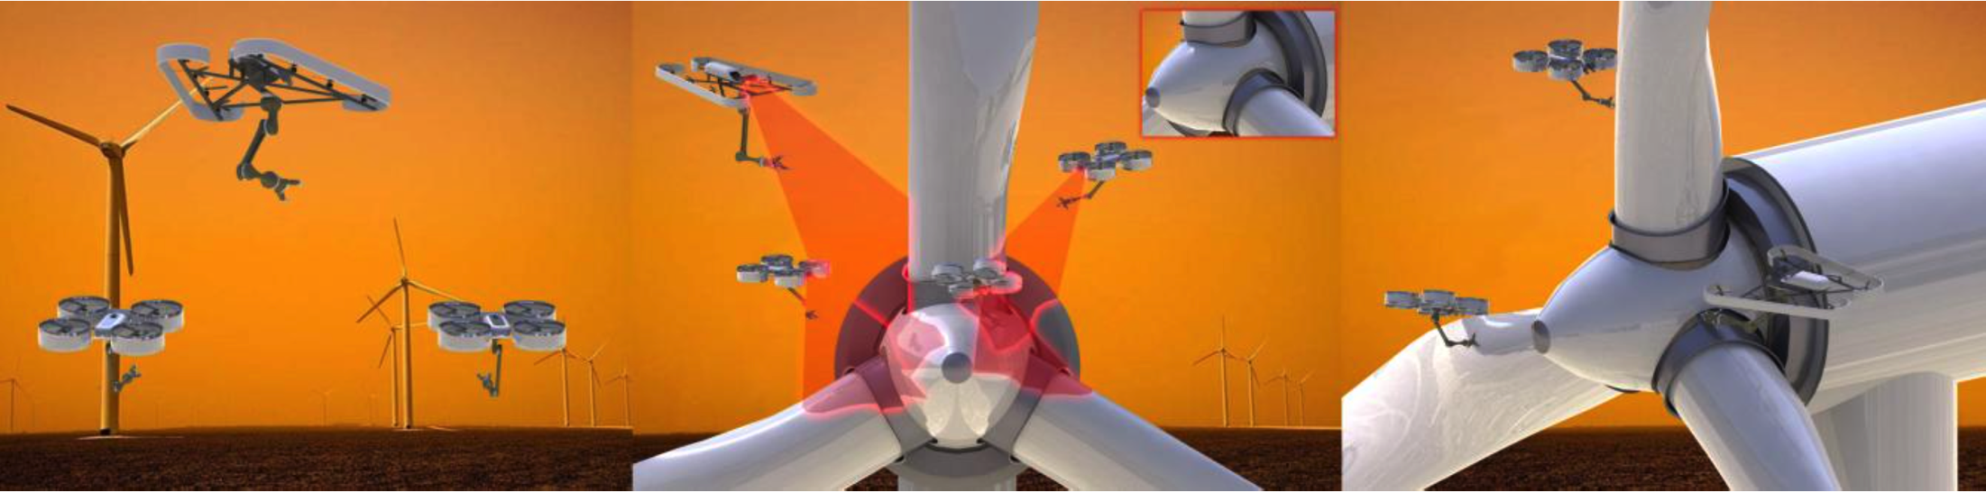
One key challenge: Single Robot Localization
Global and Local
Visual-Inertial Odometry
Complementary Properties
Lightweight
Cheap
Passive, onboard sensors

Slide 3
Rovio and Okvis
Time-Synchronization
Outlook
Comparing Rovio and Okvis: Working principles, Differences and Accuracy
Visual-Inertial Odometry on non-time-synchronized Hardware?
Outlook

Slide 4
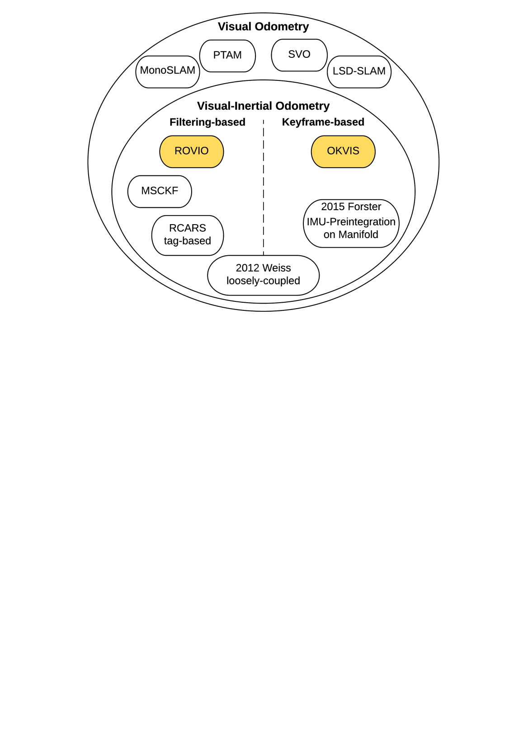
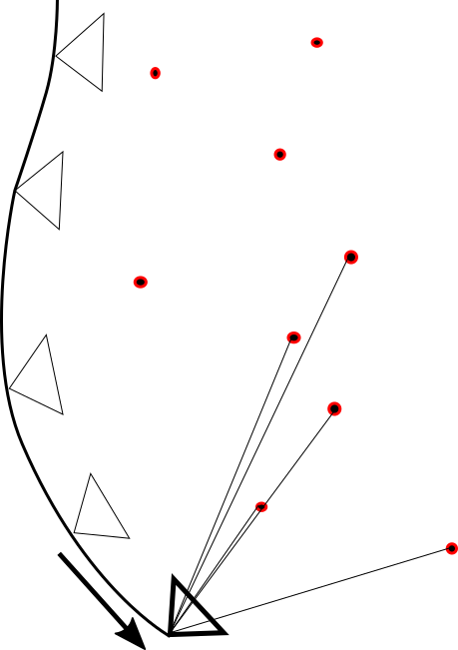
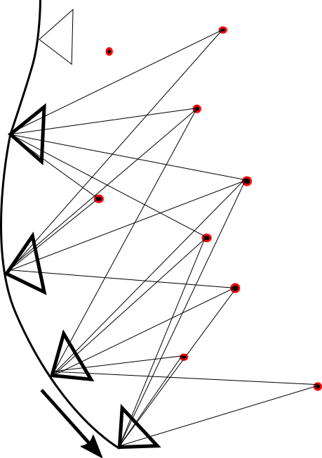
Overview
Rovio and Okvis
Time-Synchronization
Outlook

Slide 5
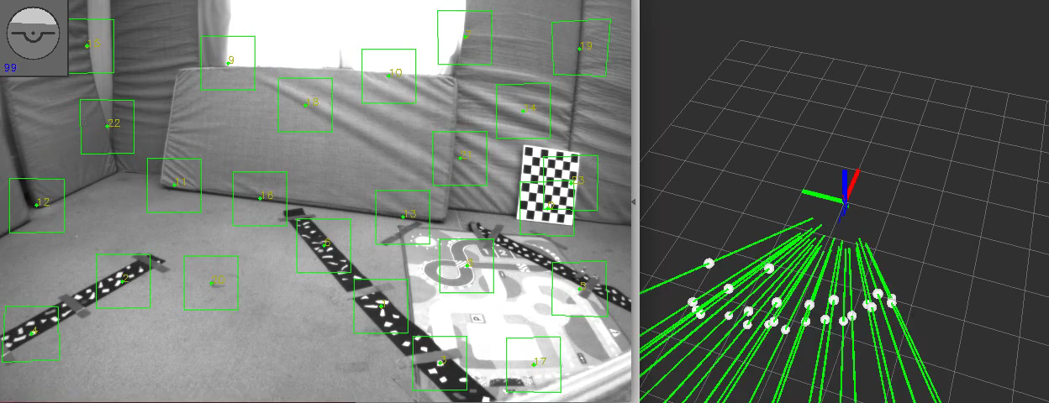
ROVIO – Robust Visual Inertial Odometry Using a Direct EKF-Based Approach
Rovio and Okvis
Time-Synchronization
Outlook
Fast Corner Detector / Multilevel Direct Intensity Patch Features
Position, Velocity, Attitude, IMU Biases, IMU-Camera Extrinsics, Features (Bearing Vector and Distance to Frame)

Slide 6
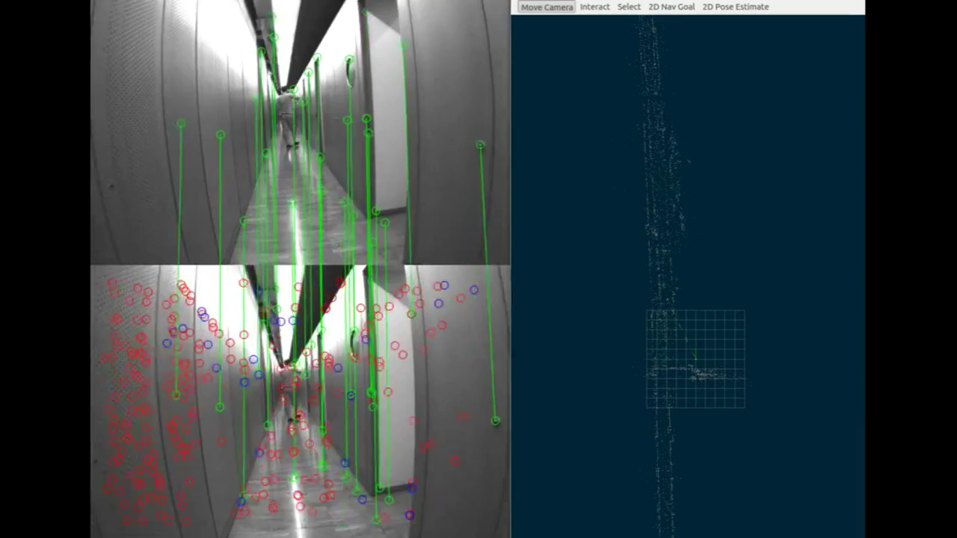
OKVIS – Optimal Keyframe-Based VI SLAM
Rovio and Okvis
Time-Synchronization
Outlook
Harris Corner Detector / BRISK Features
Nonlinear Optimization minimizing reprojection error and IMU error
Marginalization

Slide 7
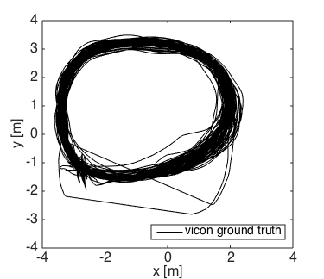
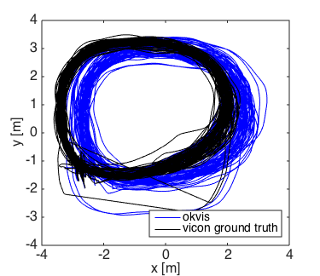
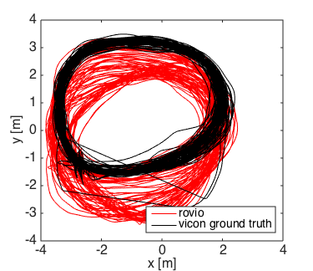
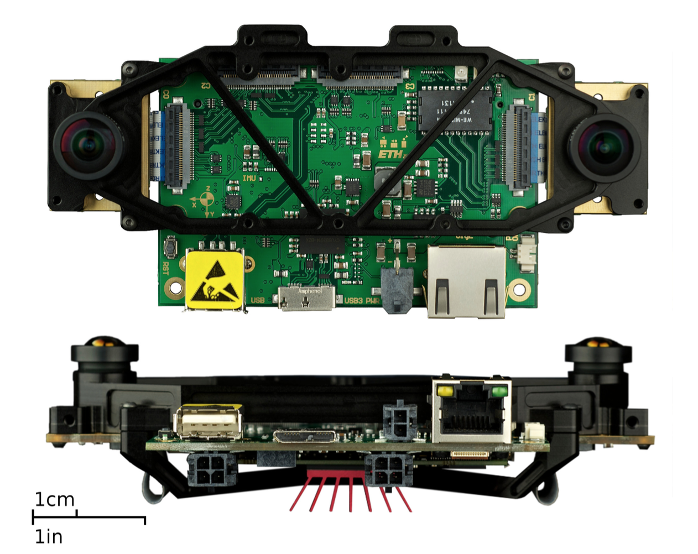
Comparison
Rovio and Okvis
Time-Synchronization
Outlook
Start /
Endpoint
VI Sensor
Distance 1200 m, handheld, 100 Loops
Dynamics: 2.5 m/s, 3 rad/s

Slide 8
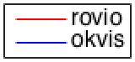
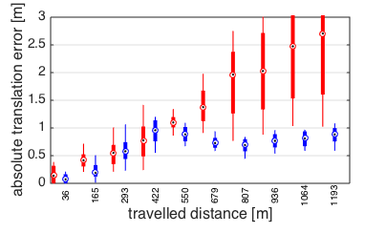
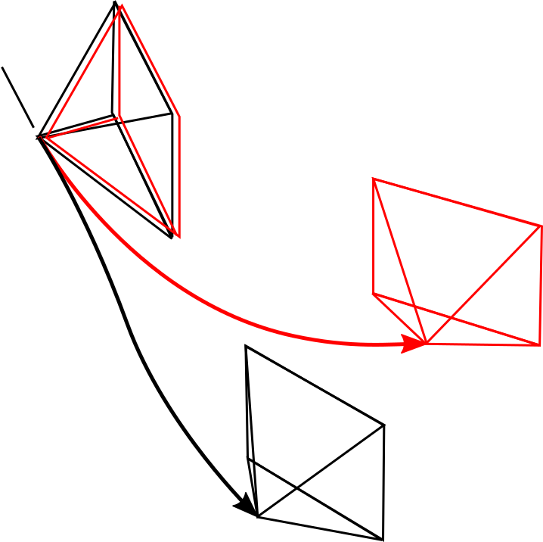
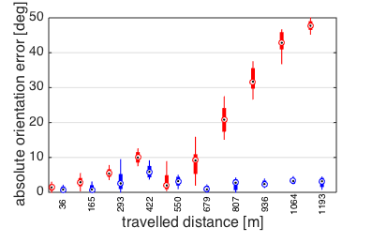
Global Accuracy
Rovio and Okvis
Time-Synchronization
Outlook

Slide 9
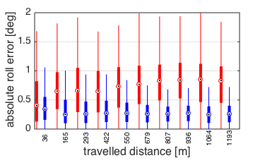
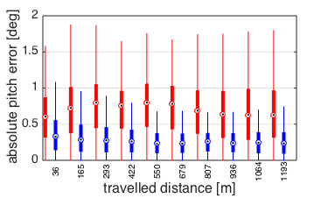
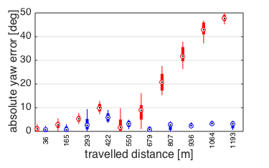
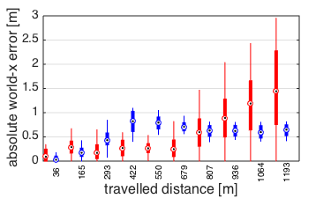
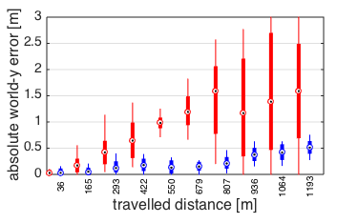
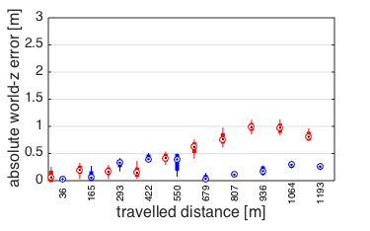
Global Accuracy – separated axes
Rovio and Okvis
Time-Synchronization
Outlook

Slide 10
Global Accuracy
Rovio and Okvis
Time-Synchronization
Outlook
Yaw Drift of Rovio 10 times higher over 1000 m
World-z Drift of Rovio 3 times higher over 1000 m

Slide 11
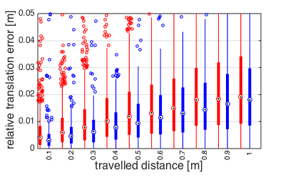
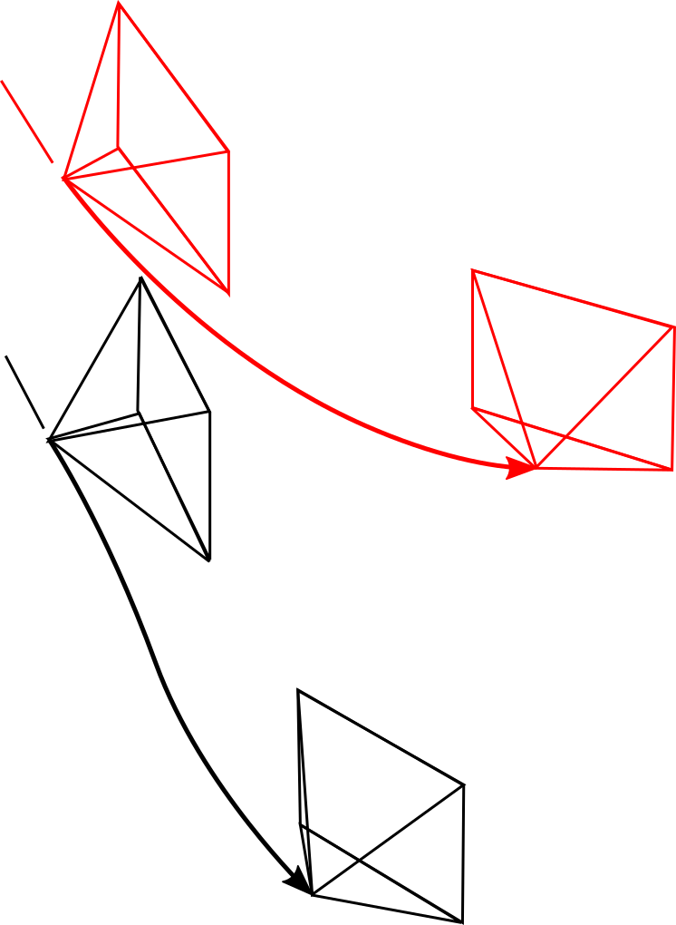
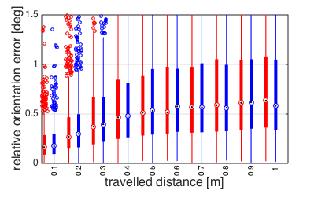
Local Accuracy
Rovio and Okvis
Time-Synchronization
Outlook

Slide 12
Results
Rovio and Okvis
Time-Synchronization
Outlook
 | Rovio | Okvis
Absolute Translation Error | 2.5 m / 1000 m | 1 m / 1000 m
Absolute Orientation Error | 45 ° / 1000 m | 4 ° / 1000 m
Absolute Yaw Error | 45 ° / 1000 m | 4 ° / 1000 m
Absolute world-z Error | 1 m / 1000 m | 30 cm / 1000 m
Relative Translation Error | 2 cm / 1 m | 2 cm / 1 m
Relative Orientation Error | 0.6 ° / 1 m | 0.6 ° / 1 m
Processing Time / Frame | 10 ms | unknown, higher

Slide 13
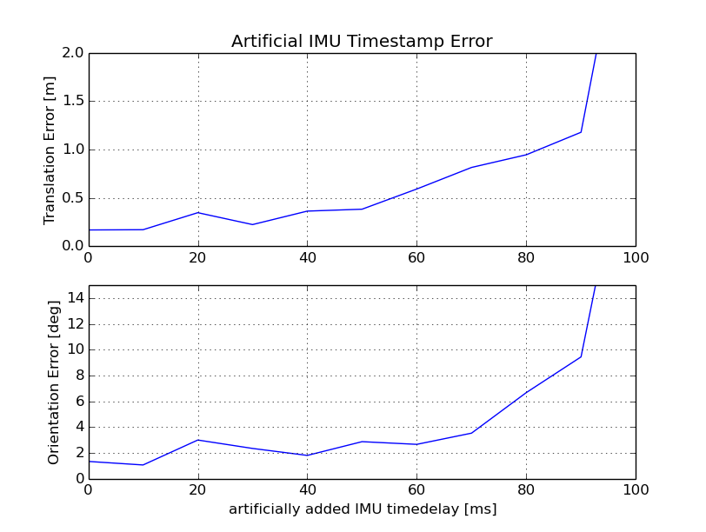
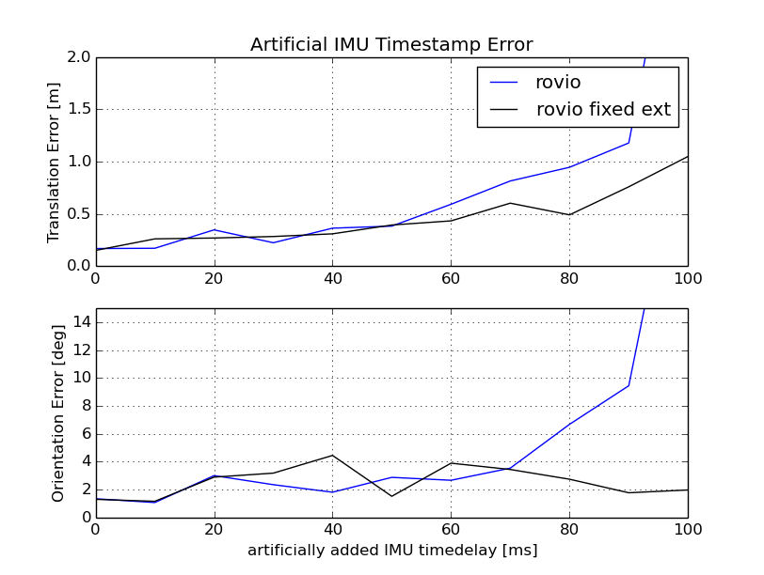
Towards non-timesynchronized Hardware 1) Analysis with artificial bias on IMU timestamp
Rovio and Okvis
Time-Synchronization
Outlook

Slide 14
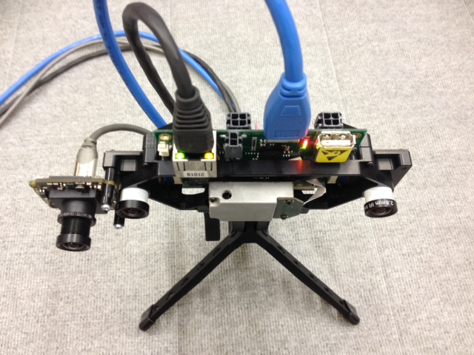
Towards non-timesynchronized Hardware 2) Real Test
Rovio and Okvis
Time-Synchronization
Outlook
VI Sensor
Bluefox 2.0
Indoor, handheld, 60 m, 3 loops
Slow and Fast Dataset

Slide 15
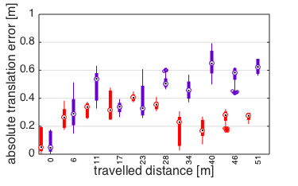
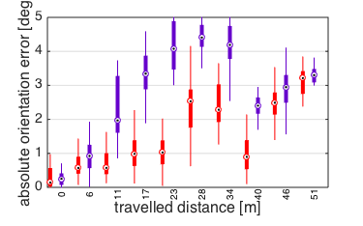
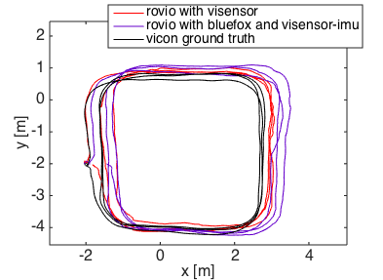
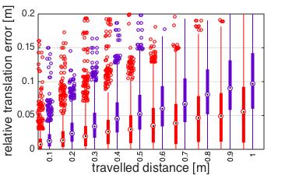
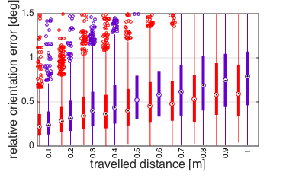
Slow Dataset
Rovio and Okvis
Time-Synchronization
Outlook
Dynamics: 1.5 m/s, 1 rad/s
Non-timesynchronized Hardware is able to track
Visensor performs better

Slide 16
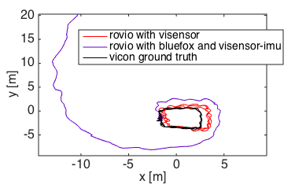
Fast dataset
Rovio and Okvis
Time-Synchronization
Outlook
Fast, shaky motions
Dynamics: 2.5 m/s, 5 rad/s
Non-timesynchronized Hardware diverging

Slide 17
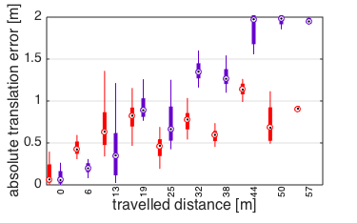
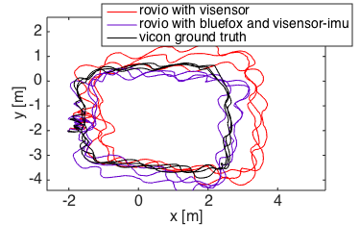
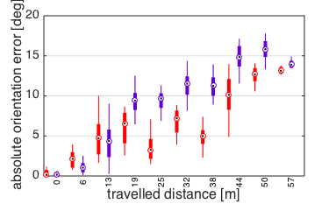
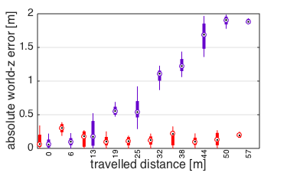
Fast dataset – Fixed Extrinsics
Rovio and Okvis
Time-Synchronization
Outlook
Fixing the Extrinsics on non-timesynced Hardware increases Rovio performance

Slide 18
Outlook
Rovio and Okvis
Time-Synchronization
Outlook
Outlook
Rovio: Combine with „Backend“ performing a Global Optimization
Rovio: Include additional Sensorinformation (GPS, Mag)
Run Rovio on Embedded system with lower-quality IMU and non-timesynchronized Hardware
Run and evaluate Okvis

Slide 19
Thank you !

Slide 22
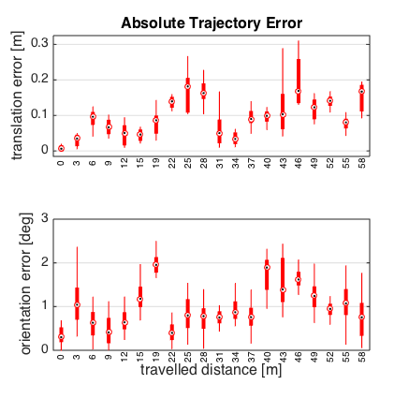
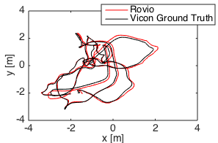
Global Accuracy – Euroc Data

Slide 23
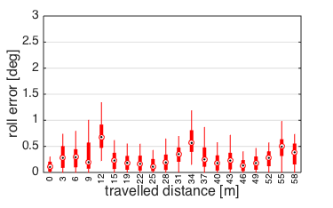
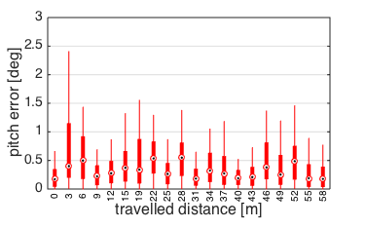
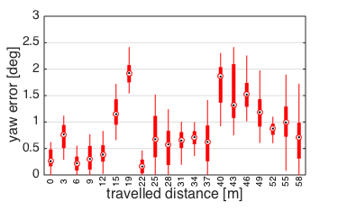
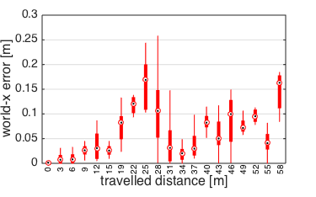
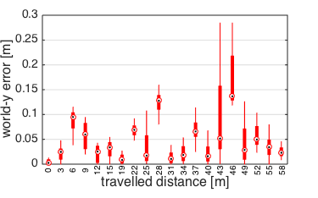
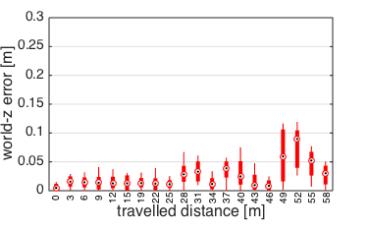
Global Accuracy – Euroc Data
AOE_Yaw = 1 deg / 50 m
ATE_Z = 5 cm / 50 m (0.1 %)

Slide 24
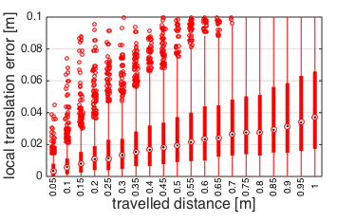
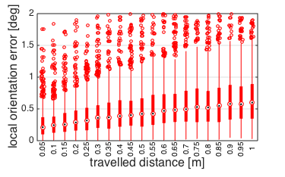
Local Accuracy – Euroc Data
RTE = 4 cm / 1 m (4 %)
ROE = 0.6° / 1 m

Slide 25
Results – Euroc Data
Rovio and Okvis
Time-Synchronization
Outlook
 | Rovio | Okvis
Absolute Translation Error | 5 cm / 50 m | -
Absolute Orientation Error | 45 ° / 50 m | -
Absolute Yaw Error | 1 ° / 50 m | -
Absolute world-z Error | 5 cm / 50 m | -
Relative Translation Error | 4 cm / 1 m | -
Relative Orientation Error | 0.6 ° / 1 m | -
Processing Time / Frame | 10 ms | unknown, higher

Slide 26
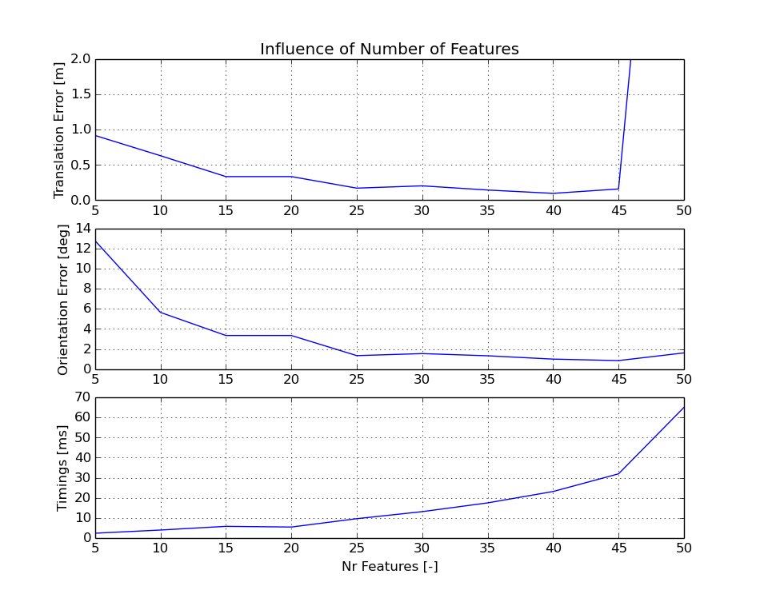
Computational Complexity / Features – Euroc Data

